Slide 1
Module 1.1:
ML Basics
Representation; Model Fitting;
Prediction; Generalization
ML for Cybersecurity
Notes:
Hi everyone, welcome back to machine learning for cybersecurity. I’m Yuxin; and in this video, we will walk through the basics setup of a machine learning pipeline, and answer several fundamental questions such as:
What are the different types of machine learning models that are commonly used for real-world application?
How to fit a machine learning model given a training dataset?
How do we measure the goodness of fit?
What are the objectives for training a “good” machine learning model, that can be used to make predictions for new, unseen data instances?

Slide 2

Taxonomy of “Classical” ML Models
Notes:
Depending on the data available and the objective of the task we are addressing, we will train our models differently. In this course module, we will introduce basic models for supervised learning, where both the input examples and output labels are given, such as training a spam filter from a set of labeled emails.
We will also discuss unsupervised learning, where only no output is given for examples. Examples include detecting network traffic anomaly, and malware detection, and so on.
In this video, we focus on the “classical” supervised learning setting, where both the input and output is given, to introduce the basic elements of a machine learning pipeline.
We will later extend our discussion to contemporary “representation learning” models, such as neural networks and deep learning in a separate video clip.

Slide 3
Elements of Statistical Learning
Notes:
Now let’s take a closer look at how a machine learning algorithm works.
======
Matt/Laura:
Might be part of your plan—but it could help to explain these with a concrete example illustrating what’s going on here (so you could say e.g. what in the given scenario the domain set would be, the objective would be, etc.)
Would also just be really explicit about how, as practitioners, they would be interacting with, say, loss functions, and where different loss functions might be good choices etc.

Slide 4
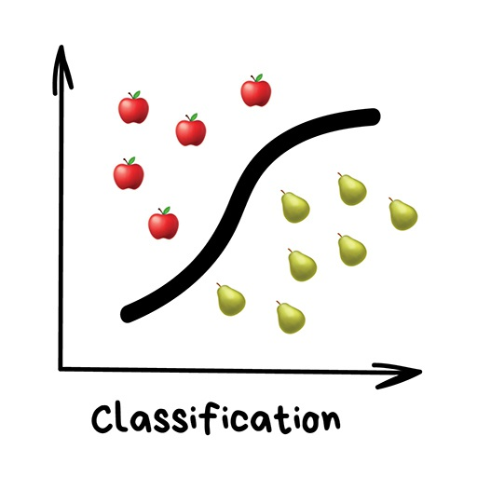
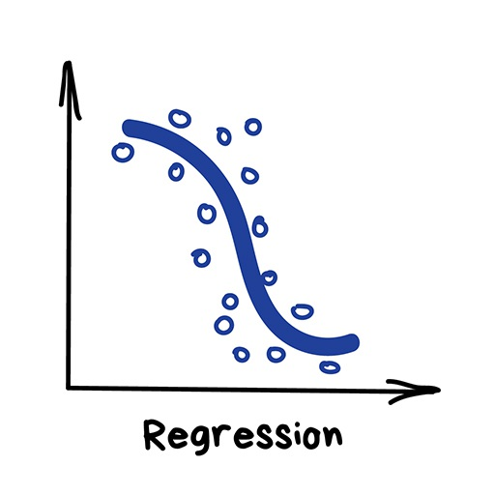
The Statistical Machine Learning Framework
Data
Domain set
Label set
A joint distribution on training data
Model
A prediction function
Notes:
As we mentioned in the previous video, a machine learning algorithm uses statistics to extracts useful patterns from data.
Let us encode the domain of the input data as X,, and the labels as Y.
The training data used as input for training the machine learning algorithm, are sampled from some unknown distribution P.
As an example, for spam filtering, X could be a large set of emails, and Y could be the labe {spam, or not not spam}.
Given the training data, the goal of supervised learning, is to fit a function, that maps from input X to Y.

Slide 5
Measurement of Success
Given the prediction function and the loss function, the loss of an example is
Training error/ empirical error of
Generalization error/ risk/ true error
Notes:
Machines learn by means of a loss function.
The loss function, \ell, is a method of evaluating how well specific algorithm models the given data.
If predictions f(x) deviates too much from actual results y, loss function would cough up a very large number.
We can train the machine learning model to learn a function that results in small training loss, or training error, defined as the empirical average of the loss on the training set.
Gradually, with the help of some optimization function, loss function learns to reduce the error in prediction.

Slide 6
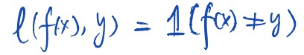
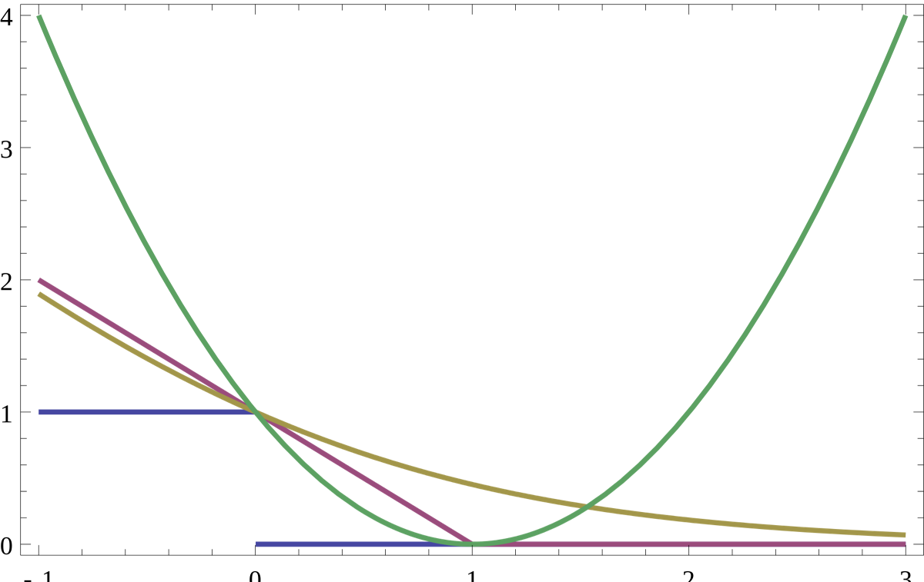
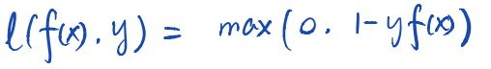
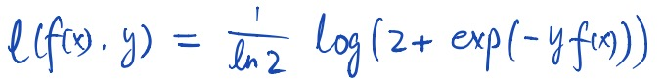
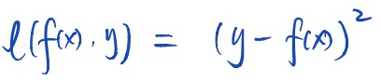
Example of Loss Functions (Classification)
0-1 loss:
misclassification error
hinge loss :
penalize correct predictions when not confident
log loss:
always wants more “margin”
square loss
magnify penalties if error is large
Notes:
There’s no one-size-fits-all loss function to algorithms in machine learning. There are various factors involved in choosing a loss function for specific problem, such as type of machine learning algorithm chosen, ease of calculating the derivatives for fitting the best parameters, and so on.
On this slide, we can see a few examples of candidate loss functions for classification.
As a practitioner, you should know when to choose what loss functions, depending on the specification of the task.
https://www.analyticsvidhya.com/blog/2019/08/detailed-guide-7-loss-functions-machine-learning-python-code/

Slide 7
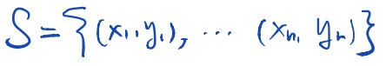
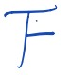
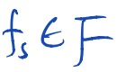
Learning Objective
Given
a collection of observations,
a model class,
The goal of learning is to determine an estimator
that best matches the observation (i.e., with the minimal error w.r.t. a certain loss function)

Slide 8
Regularization
Notes:
After seeing the basic setup of a machine learning model, we now focus on a technique, called regularization, that helps in avoiding overfitting and also increasing model interpretability.
====
Matt/Laura:
Just want to make sure there’s some sort of transition here, moving from basic ML terminology and objectives to regularization
Likewise, any concrete example(s) you can bring to bear here to illustrate would be extremely valuable

Slide 9
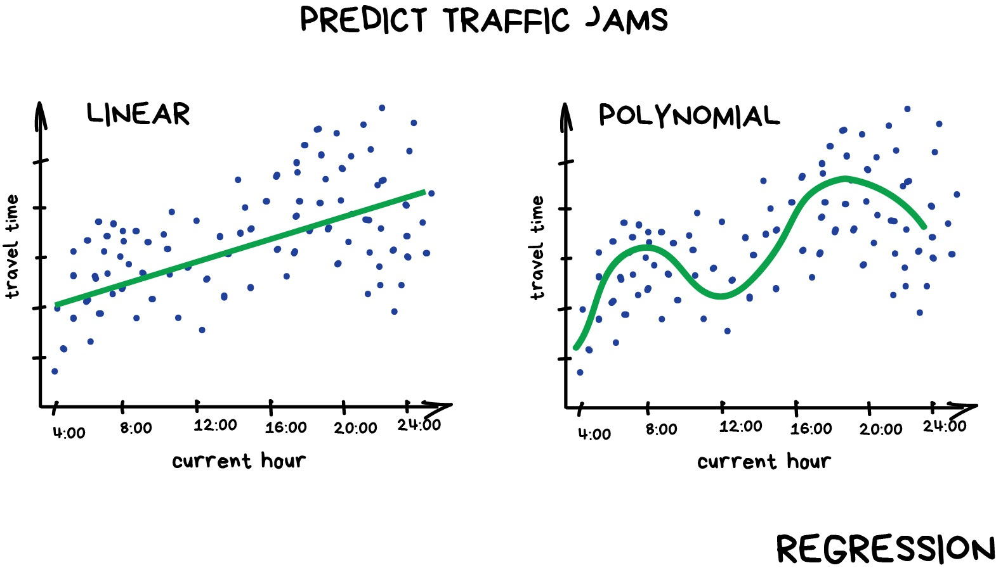
Overfitting
Notes:
Overfitting happens because your model is trying too hard to capture the noise in your training dataset.
By noise we mean the data points that don’t really represent the true properties of your data, but random chance

Slide 10
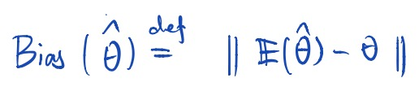
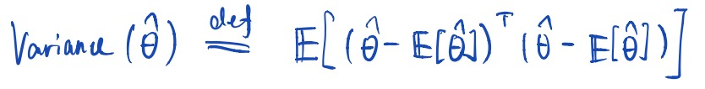
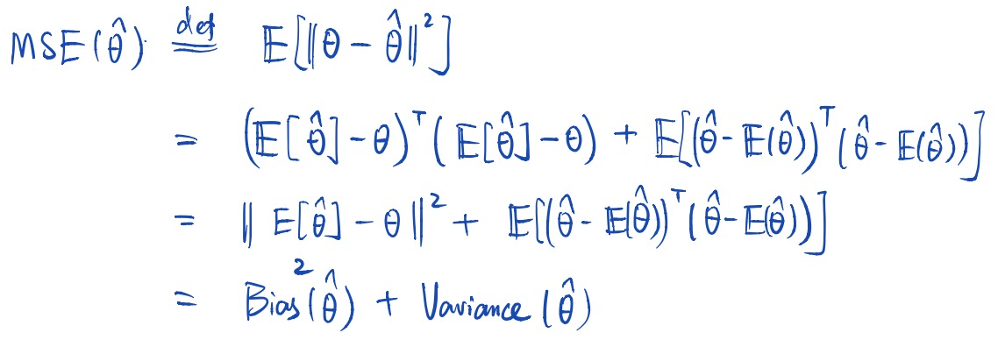
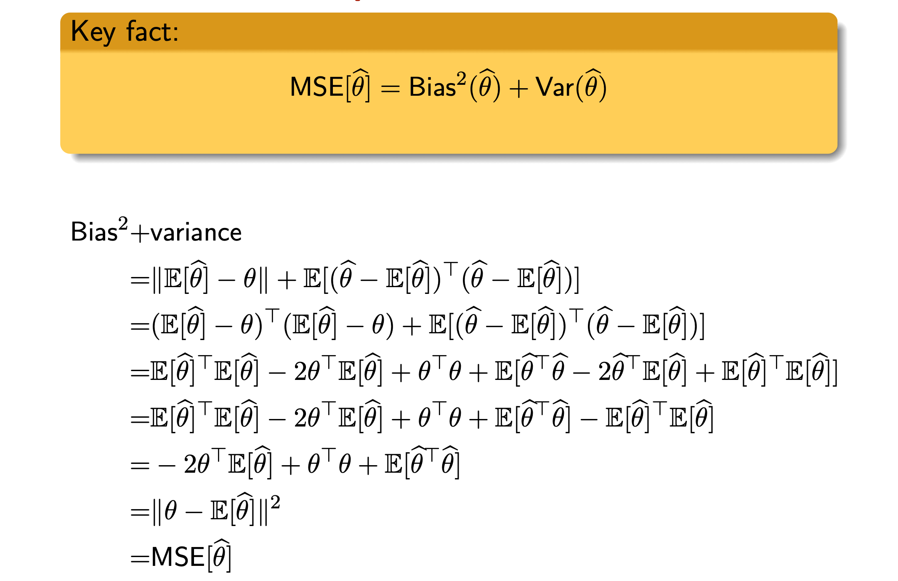
Bias-Variance Decomposition
Bias
Variance
Mean Squared Error (MSE)
bias
variance
MSE
k

Slide 11
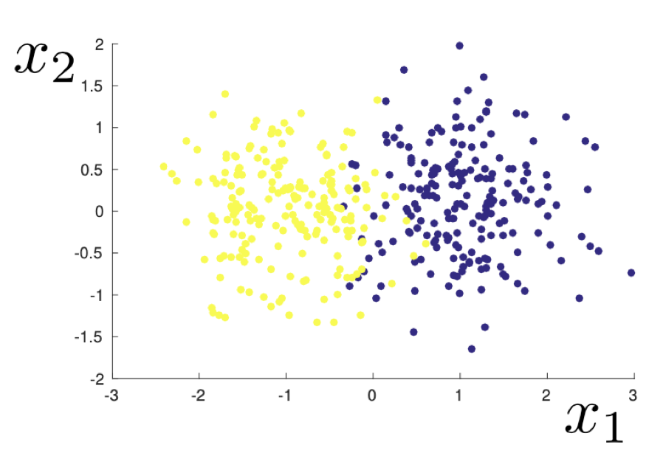
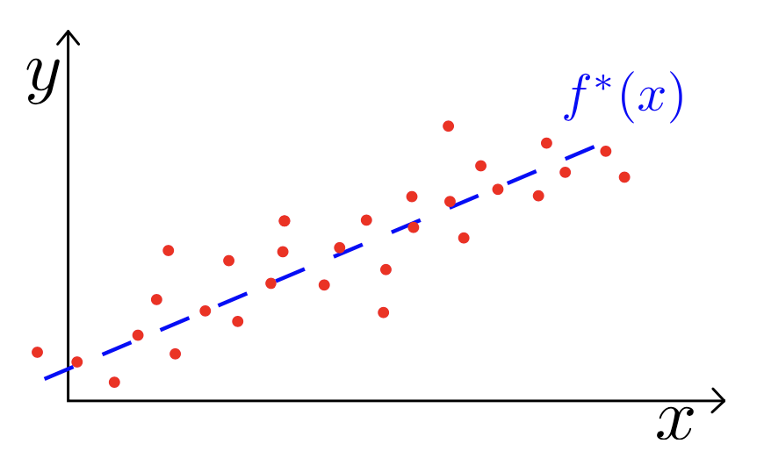
Stability, Overfitting, and Regularization
2D example of a dataset sampled from a mixed Gaussian distribution
Fixed unknown linear function
Notes:
this technique discourages learning a more complex or flexible model, so as to avoid the risk of overfitting.

